Slide 1
Helix Training
Helix analytics report
- PP&EA
Presented by Tae-uk Kim
12 July 2021

Slide 2
Table of contents
I
Understanding data of PPE
1.1 PPE Analyzer data template
1.2 Understanding Column
Ⅱ
Building PPE analyzer practice
2.1 Data Transformation
2.2 Reconciliation
Ⅲ
Training Session

Slide 3

Understanding data of PPE 1.1 PPE Analyzer data template
PPE Analyzer data template to prepare data for the EY Helix PPE Analyzer
Data file required:
Fixed asset register

Slide 4
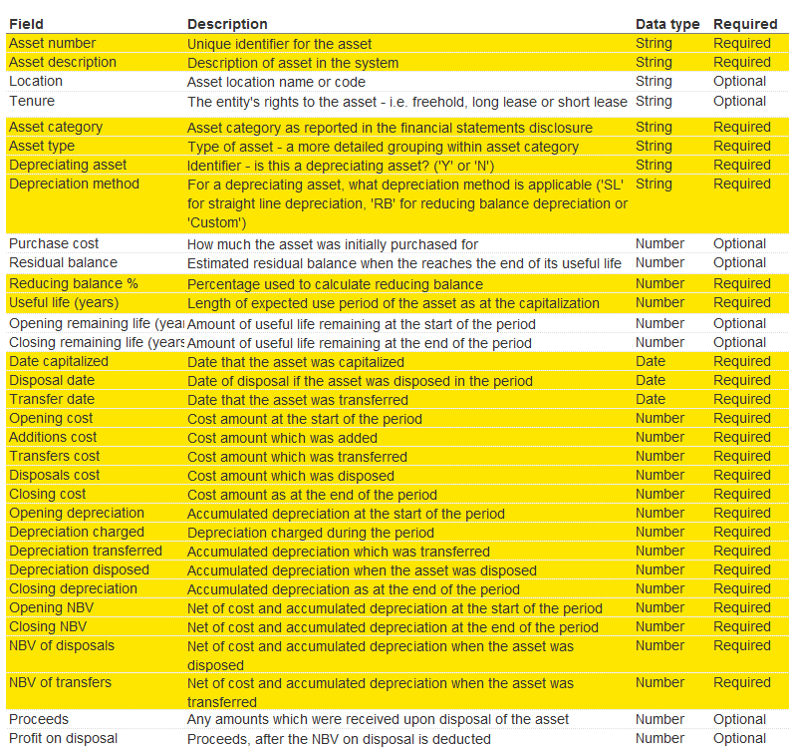
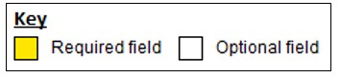
Understanding data of PPE 1.2 Understanding Column

Slide 5
Building PPE analyzer practice 2.1 Data Transformation
주요 SAP Report
No | Data | SAP report T-code
1 | PP&E register | S_ALR_87011963 - Asset Balances
2 | Additions | S_ALR_87012050 - Asset Acquisitions
3 | Disposals | S_ALR_87012052 - Asset Retirements
4 | Depreciation | S_ALR_87012004 - Total Depreciation
5 | Transfers | S_ALR_87012054 – Intercompany Asset Transfer
자산 원장
 | Asset Code | Asset Description | Asset Category | Data Capitalized | Useful life | Opening | Addition | Transfer | Disposal | Ending
Data | 4010016735 | 영흥 인공골재 | 기계장치 | 2013.09.01 | 31 | 4,607,280,580 | 8,355,270 | 1,766,014,173 | -76,650,541 | 6,304,999,482
SAP T-code | No.1 |  |  |  | No.4 | No.1 | No.2 | No.5 | No.3 | No.1
자산 원장 (감가상각 누계)
 | Asset Code | Asset Description | Asset Category | Data Capitalized | Useful life | Opening Depreciation | Depreciation | Transfer | Disposal | Closing Depreciation
Data | 4010016735 | 영흥 인공 골재 | 기계장치 | 2013.09.01 | 31 | -711,077,801 | -87,152,625 | 0 | 0 | -798,230,426
SAP T-code | No.1 |  |  |  | No.4 | No.1 | No.2 | No.5 | No.3 | No.1

Slide 6
Building PPE analyzer practice 2.2 Reconciliation
자산 원장 <> System TB

Slide 7
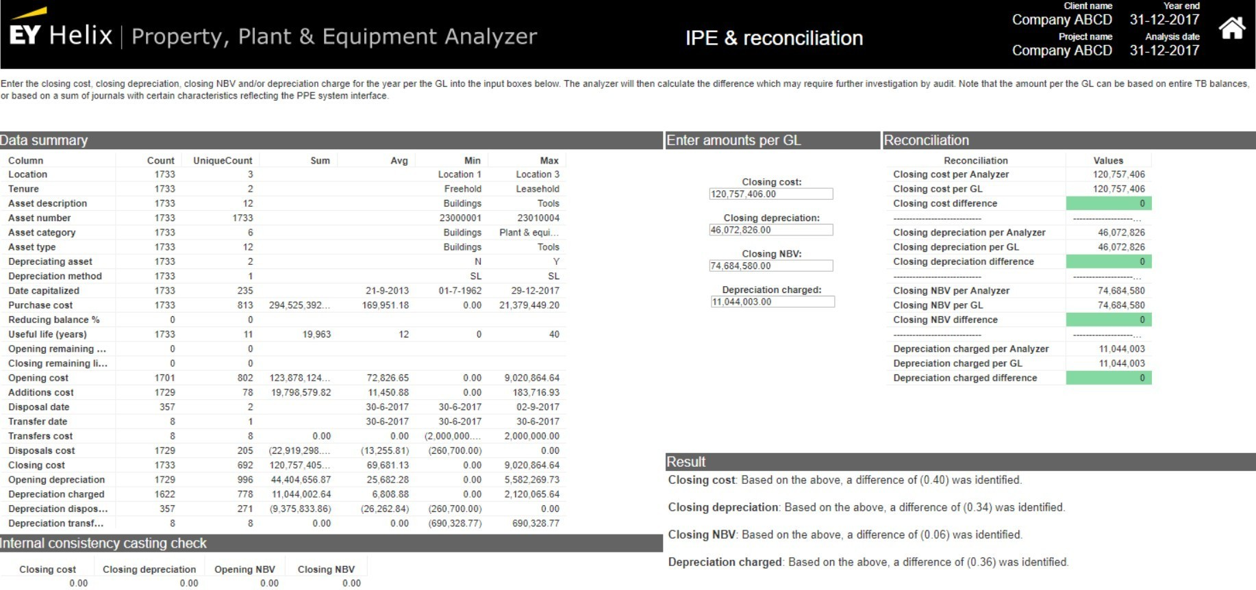
Building PPE analyzer practice 2.2 Reconciliation
Helix를 활용한 PP&E Reconciliation 검증 내역
1
2
Closing cost
TB Asset 기말 금액 입력
Closing Depreciation
TB 감가상각 누계 기말 금액 입력

Slide 8
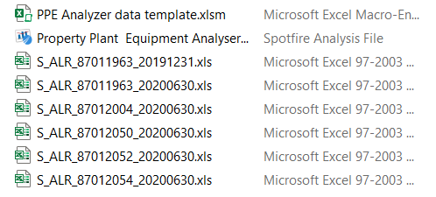
Training Session

Slide 9
Q&A

Slide 10
감사합니다.

